Slide 1
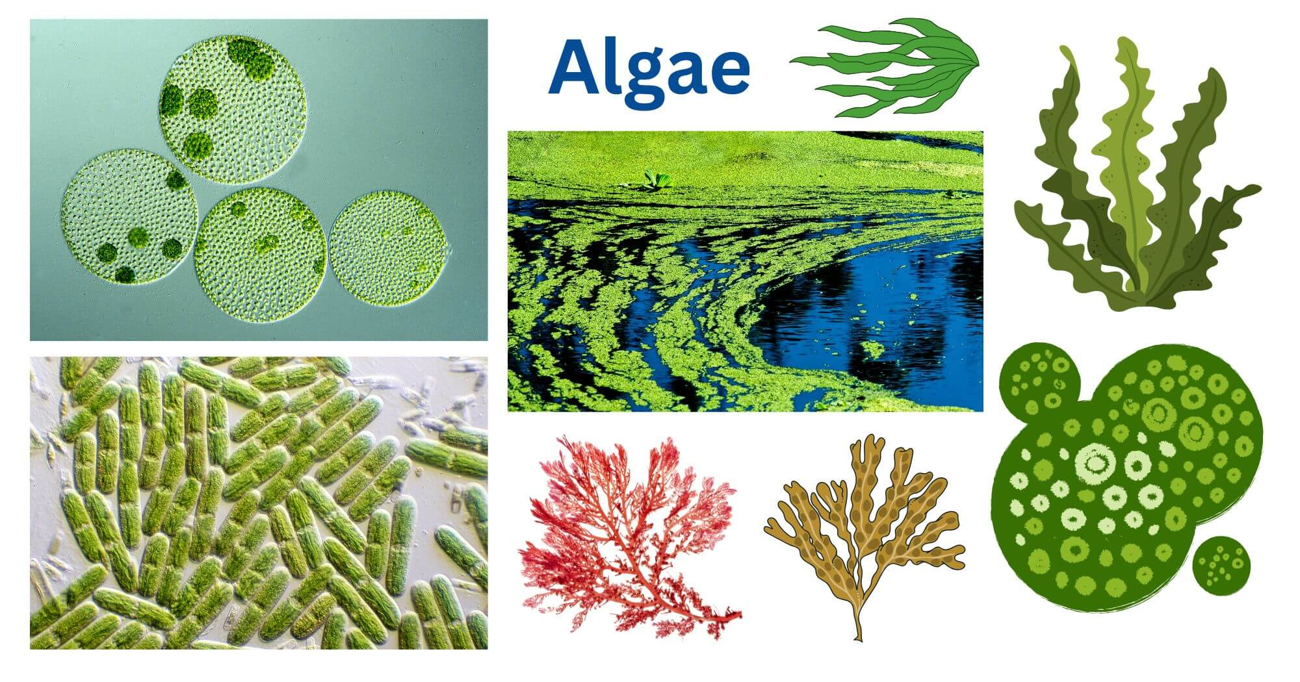
Reproduction in Algae
Dr. Trilok Kumar
Assistant Professor
Govt. Digvijay Autonomous PG College, Rajnandgaon, C.G.

Slide 2
REPRODUCTION IN ALGAE
Algae reproduce by following 3 methods:
Vegetative
Asexual
Sexual

Slide 3
1-Vegetative Reproduction
The vegetative reproduction in algae takes place by following methods:
(i) Fragmentation- Fragmentation is common in filamentous forms. In this process, filament breaks into fragments and each fragment give rise to a new filamentous thallus.
The common examples are Ulothrix, Spirogyra, Oedogonium, Zygnema, Oscillatoria, Nostoc etc.
(ii) Fission- This process is common in Desmids, Diatoms, and other unicellular algae. The cell divides into two by mitotic division and then separation occurs through septum formation.
(iii) Adventitious branches- Protonema develops in certain algae like Chara and give rise to new thalli when detached from parent thallus. These adventitious branches develop mainly on the rhizoids. Other examples include Dictyota and Fucus.

Slide 4
(iv)Tubers- Tubers are spherical or globular bodies which are found on lower nodes or rhizoids of Chara. These tubers when detach from parent plant can give rise to new thalli.
(v)Amylum stars- In Chara, star shaped bodies filled with amylum starch are formed that give rise to new individual after detaching from the parent plant.
(vi) Budding- In some algae like Protosiphon, budding takes place which results in new individuals.
(vii) Hormogonia- In some cyanobacteria like Nostoc, Cylindrospermum hormogonia develop that may give rise to new thalli. These hormogonia are of varying lengths and may develop at the place of heterocysts in the thallus. These hormogones are produced by breakage of filament into two or more cells.
(viii) Hormospores or hormocysts- Hormospores are thick walled hormogones which are produced in drier conditions.

Slide 5
2-Asexual Reproduction
In a large number of algae asexual reproductions takes place with the help of different kind of spores and other structures.
Basically, spores are meant for asexual reproduction and each spore can grow into a new thallus.
Spores are one celled structure and are produced internally in the case of algae.
They are produced within the vegetative cell (Chlamydomonas) or in a specialized structure called sporangia.
They may be motile or non-motile.
Motile spores are called zoospores and non-motile as aplanospores.

Slide 6
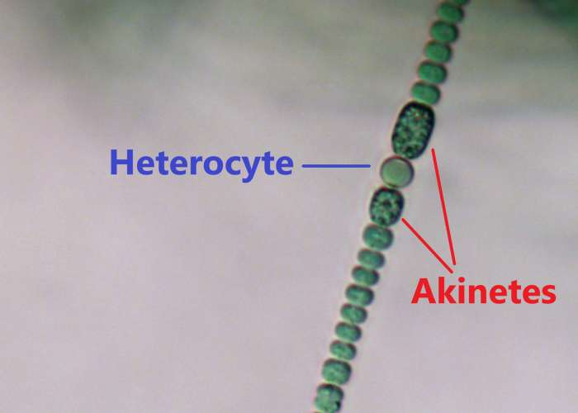
Different types of asexual spores and structures are as follows:
(i)Akinetes-
In filamentous forms, certain vegetative cells become thick walled elongated structures called as akinetes.
Akinetes are perrenating bodies that can survive under unfavourable conditions and can give rise to new individual on occurrence of favourable conditions.
e.g. Anabaena

Slide 7
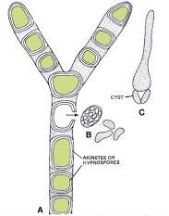
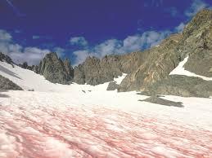
(ii) Hypnospores-
Hypnospores are thick walled, non flagellated spores with plenty of food reserves.
They are perrenating structures.
Hypnospores are produced under unfavourable conditions by some green algae.
They germinate into new plants with return of favourable environmental conditions.
e.g.: Vaucheria, Chlamydomonas, Protosiphon.
In Chlamydomonas nivalis the walls of hypnospores become red due to the presence of pigment Haematochrome due to which snow becomes red.
Vaucheria: Hypnospores
Chlamydomonas nivalis

Slide 8
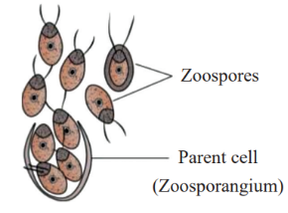
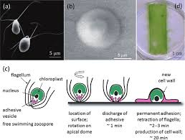
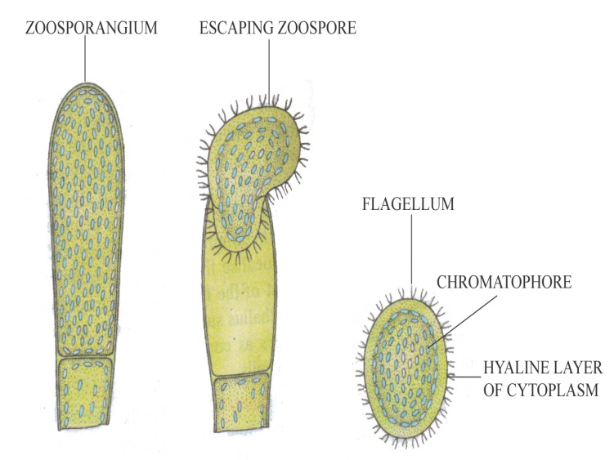
(iii) Zoospores-
These are flagellated asexual spores which are formed in zoosporangium or directly from the vegetative cells.
The zoospores may be biflagellated, quadriflagellate or multiflagellate.
The multiflagellate zoospores are of again two types- flagella arranged on entire length of body or arranged in a ring surrounding a beak like projection.
e.g.: Chlamydomonas (biflagellate), Ulva, Ulothrix, Cladophora (quadriflagellate), Vaucheria, Oedogonium (multiflagellate).
Chlamydomonas (biflagellate) Ulva (Quadriflagellate) Vaucheria (Multiflagellate)

Slide 9
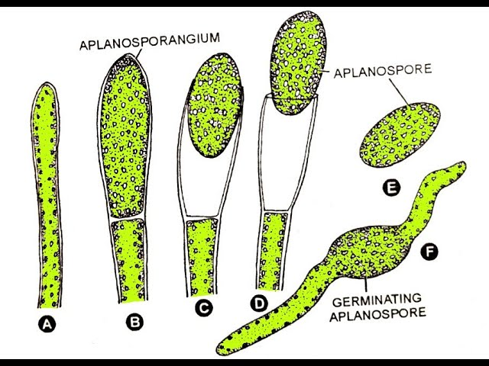
(iv) Aplanospores
These are non flagellated, non- motile thin walled asexual spores.
These spores are formed during unfavourable conditions.
After releasing each aplanospore germinates to form a new thallus. e.g. Vaucheria
Aplanospore in Vaucheria

Slide 10
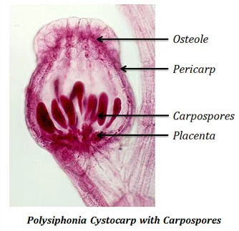
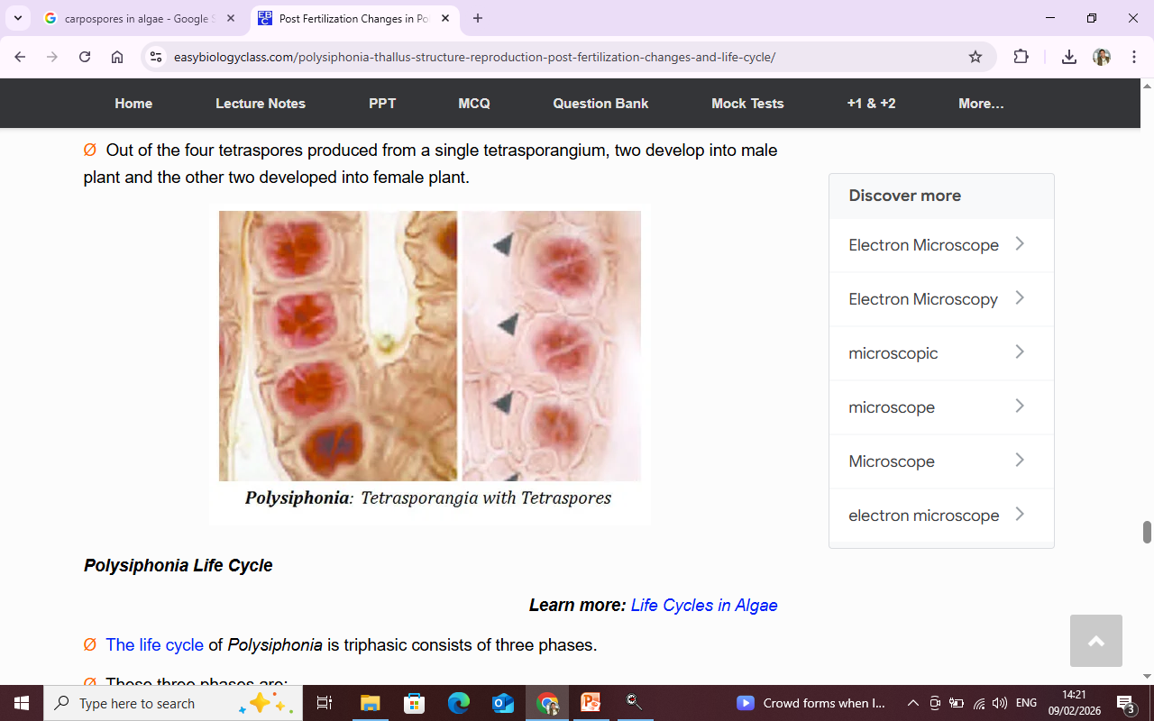
(v) Carpospores- Carpospores are produced in carposporophyte of red algae. e.g. Polysiphonia
(vi) Tetraspores- Tetraspores are non motile asexual spores that are formed in some members of Rhodophyceae and Phaeophyceae. Tetraspores are formed in tetrads in the tetrasporangia.
e.g., Polysiphonia

Slide 11
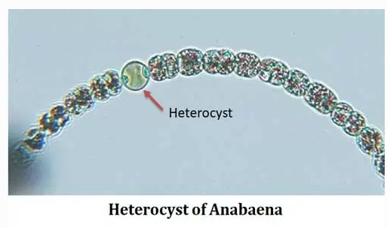
(vii) Heterocysts-
These structures are found in blue green algae and depending upon the position in thallus they may be terminal or interstitial.

Slide 12
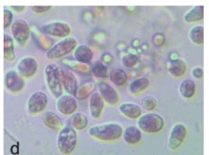
(viii) Monospores-
Single spore formed in the sporangia is called monospore.
Monospores are found as asexual mode of reproduction in some members of Rhodophyceae.
Some red algae produce monospores (walled, nonflagellate, spherical cells) that are carried by water currents and upon germination produce a new organism.
E,g, Pyropia

Slide 13
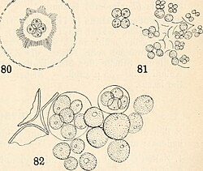
(ix) Autospores-
Autospores are a type of spores that are produced by algae to enable asexual reproduction and spread.
They are non-motile and non-flagellated aplanospores that are generated within a parent cell and have the same shape as the parent cell before their release.
Autospores are also known as resting spores. E.g.: Scenedemus
Reproduction of Radiococcus and Tetracoccus by forming 4 autospores within a single cell

Slide 14
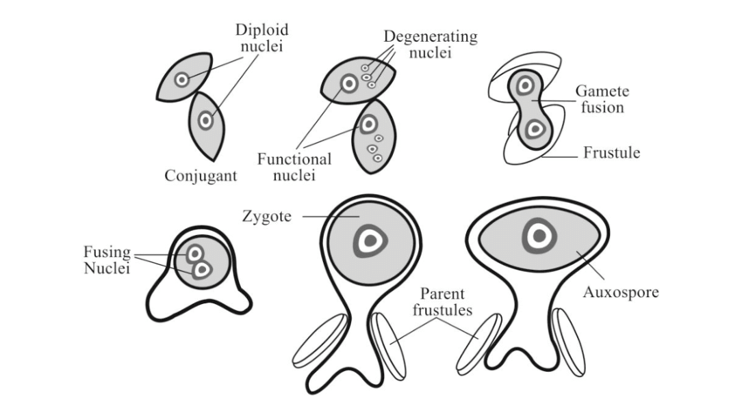
(x) Auxospores-
Auxospores are produced in the member of Bacillariophyceae. E.g. Diatoms

Slide 15
(xi) Paraspores-
Paraspores are specialized spores produced by certain red algae (family Ceramiaceae) that function either as tetraspores or germinate to produce a triploid generation.
In some members of Rhodophyceae, paraspores are formed that give rise to new individual.

Slide 16
(xii) Statospores-
Statospores are produced in the members of Chrysophyte algae (Golden algae) and in some Diatoms, Bacillariophyceae and Xanthophyceae.
These are thick-walled, non-motile resting spores.
These are asexual perrenating bodies that may give rise to new individual upon occurrence of favourable condition.

Slide 17
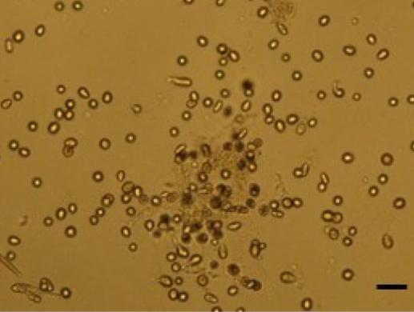
(xiii) Neutral spores-
In some alga, the protoplast of vegetative cells directly functions as spores and these are called neutral spores.
E.g., Asterocystis, Ectocarpus, Pyropia
Neutral spores in Pyropia

Slide 18
(xiv) Nannocytes/Nanocytes-
In the members of chroococcales, the cell content divide repeatedly to produce numerous very small spores.
The name nannocytes to these very small spores was given by Geitler.
E.g., Macrocystis, Gloeocapsa.

Slide 19
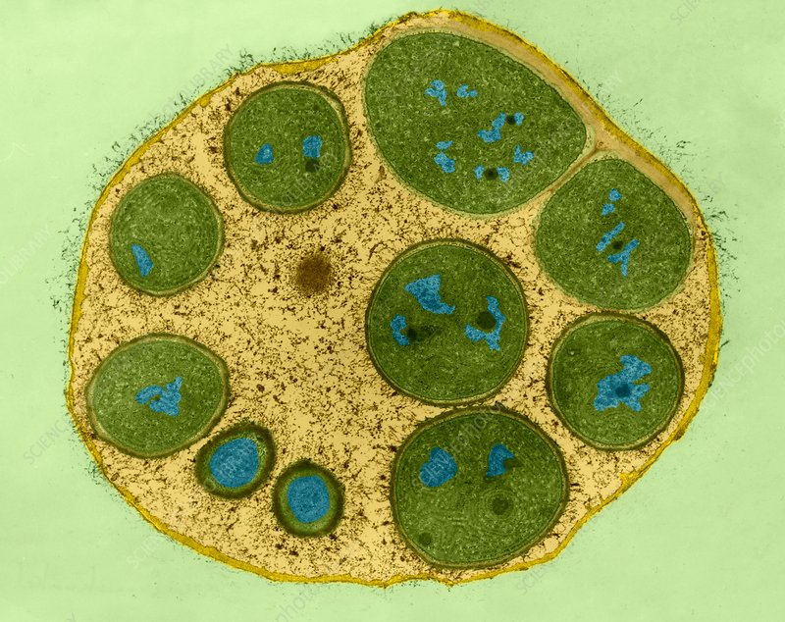
(xv) Endospores:
These are minute spores.
It is formed in unicellular algae.
The protoplast of vegetative cell divide repeatedly to form large no. of unicellular and uninucleate spores called endospores
e.g.: Dermocarpa
Endospores in Dermocarpa

Slide 20
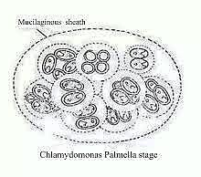
(xvi) Palmella stage:
The palmella stage is a non-motile, resting phase in certain algae (e.g., Chlamydomonas, Ulothrix) where cells lose flagella, divide repeatedly, and become embedded in a gelatinous mucilage. Triggered by unfavorable environmental conditions.

Slide 21
Sexual Reproduction in Algae
Sexual reproduction takes place by fusion of gametes of different sexuality.
There is a wide range of variation in the nature of gametes and the mode of sexual reproduction.
Any vegetative cell of thallus may produce gametes and thus behave as gametangium or a specialized gametangium may be developed.
The gametangia may be morphologically similar (isogametangia) or dissimilar (heterogametangia).
The gametes are produced in the gametangia by simple mitotic division or by reduction division.
The haploid gametes fuse to make diploid zygote that give rise to the thallus.

Slide 22
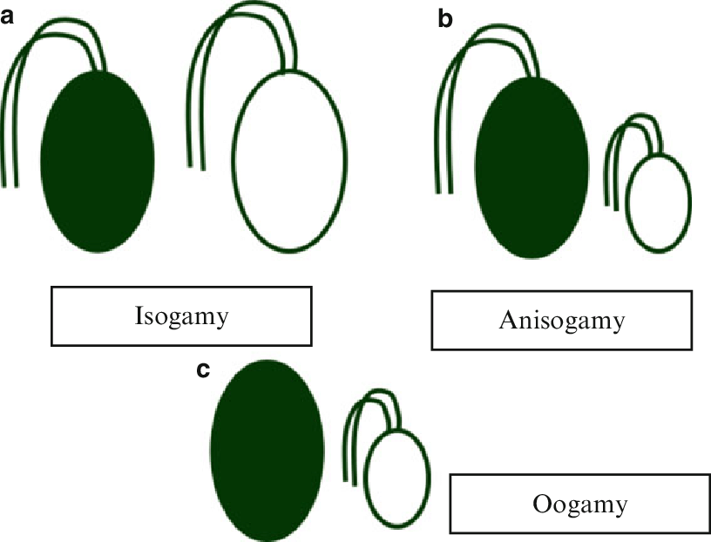
TYPES OF SEXUAL REPRODUCTION
Depending upon the morphological and physiological characteristics of gametes:
(i) Isogamous-
When fusing gametes are morphologically similar and physiologically different (+ and -) then the sexual reproduction is called as isogamous.
E.g., Chlamydomonas, Ulothrix, Zygnema, Spirogyra.

Slide 23
(ii) Anisogamous-
In anisogamous sexual reproduction fusing gametes are morphologically as well as physiologically different.
The gametes are produced in different gametangia.
The microgametes are male gametes while macrogametes are female gametes.
e.g., Chlamydomonas

Slide 24
(iii) Oogamous-
Oogamy is the most advanced type of sexual reproduction in which microgamete or male gamete fuses with a large female gamete or egg.
Male gametes are produced in antheridium while female gamete or egg is produced within a structure called as oogonium.
During fertilization male gamete reaches the oogonium to fertilize the egg and a diploid zygote is formed.
e.g., Chlamydomonas.

Slide 25
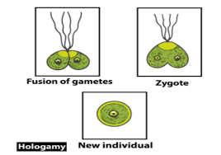
(iv) Hologamy-
In certain unicellular algae whole thallus behaves like gamete and in this process fusion takes place between opposite strained gametes or thalli that after fusion make diploid zygote.
e.g., Chlamydomonas.

Slide 26
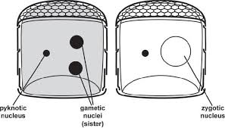
(v) Autogamy-
In autogamy fusion between two gametes of opposite strains from same mother cell takes place.
Since both the fusion gametes comes from same mother cell there is no genetic recombination.
A fusion of male and female gametes produced by single individuals.
It is also known as self-fertilization.
e.g., Diatoms.

